Slide 1
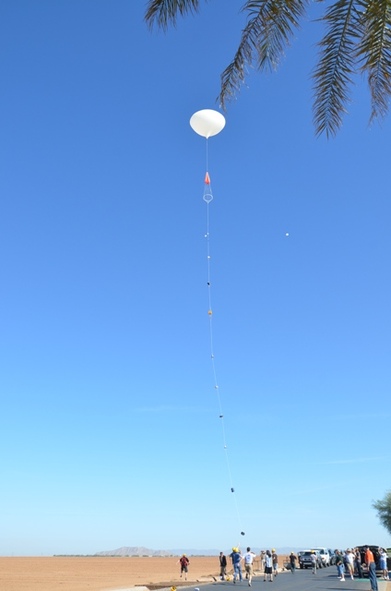
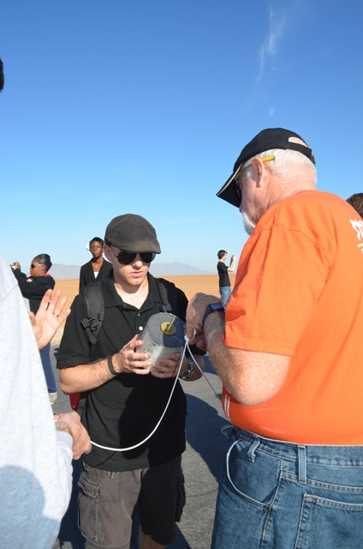
Day before launch
On the day before launch our team had a functional payload. The capsule was intact and clean, the sensors were reading, and the picaxe was logging sensor data. The program was designed to cycle the GoPro camera through a fifteen-minute video recording and ten-minute power-save pattern throughout the flight; however a problem with a solenoid resulted in the interface not working.

Slide 2
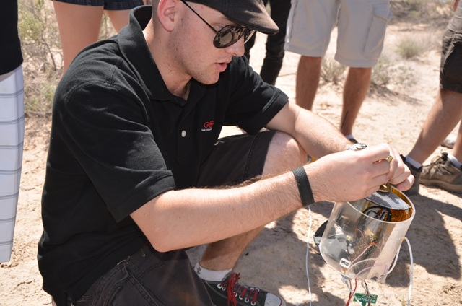
Day before launch
This was not a real problem as we could easily just turn the camera on manually before launch. We chose to run the camera so that it would take a still shot every ten seconds until either the battery died or it ran out of memory.

Slide 3
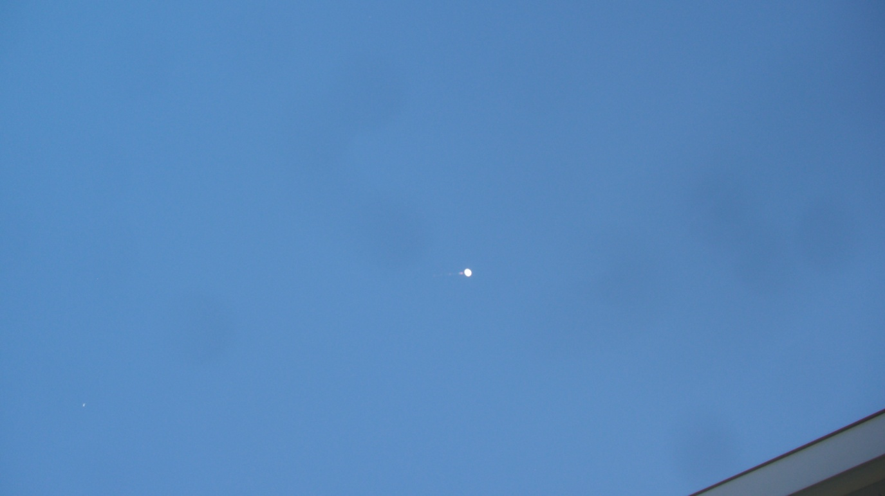
Launch Day
We tested the data logging portion of the program several times over the course of the day and night before the launch, concluding that the payload did indeed work satisfactorily.

Slide 4
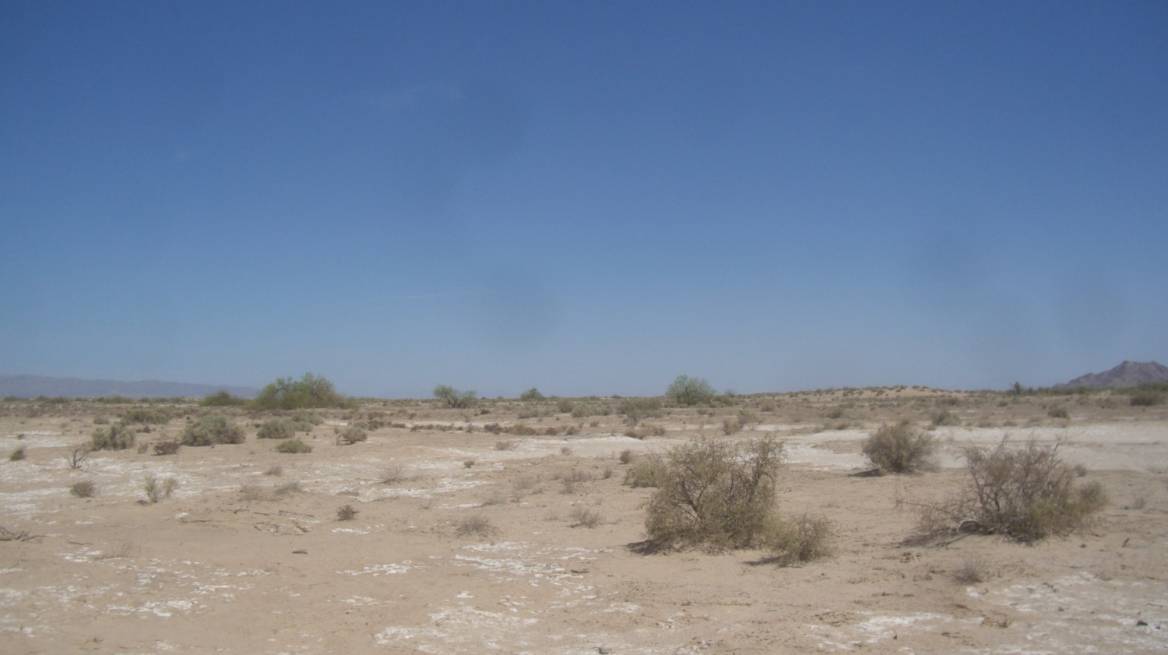
Day before launch
The morning of the launch, we drove out to the launch site, arriving at 8am, at which point we began final preparations. This is where we encountered our first major problem. Just before the nine o’clock launch, we plugged the picaxe into the laptop to load and initiate the data logging program as we had countless times, only this time the programming software came up with an error message saying that a connection could not be made.

Slide 5
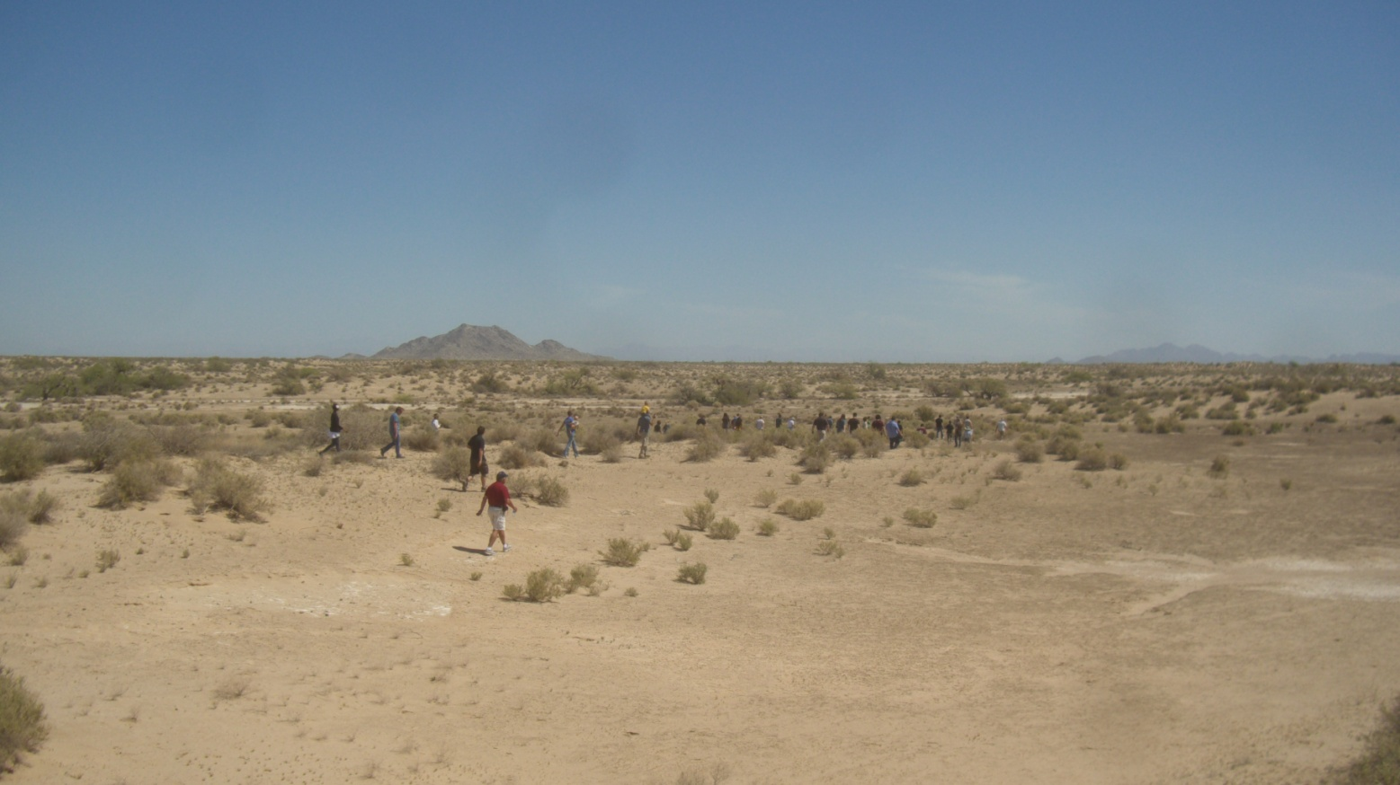
Day before launch
Somehow, between the last test we did and this critical moment, something went wrong and now the software on the laptop could not communicate with the payload computer! We made several attempts to no avail, and finally, just before launch, decided to send the payload up with only the camera running.

Slide 6
Recovery
About two hours later, we received news that the balloon was descending, and began the chase. After driving through both urban and off-road terrain, we finally found the landing site in the middle of the desert.

Slide 7
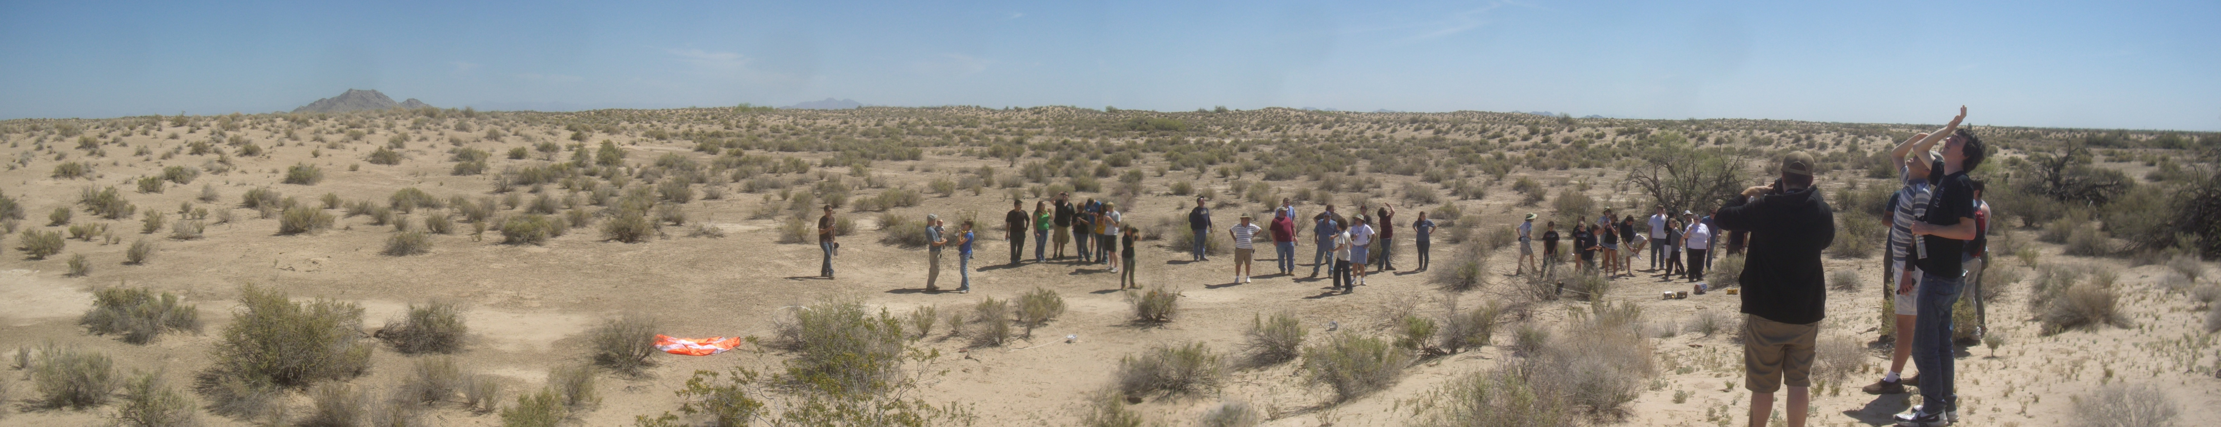
Recovery
Our first view of our payload was disheartening, as it had obviously gotten tangled with its neighbors on descent and came out worse for wear. We could see the capsule had cracked badly. Closer inspection was even more demoralizing.

Slide 8
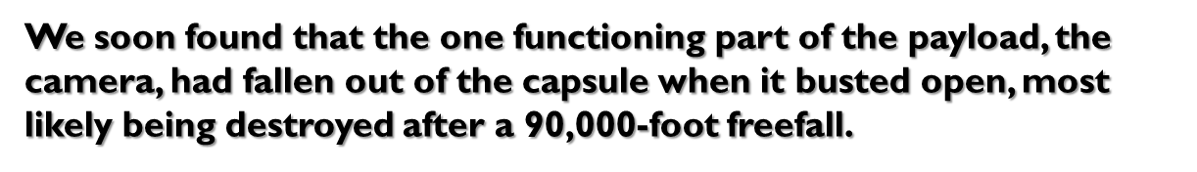
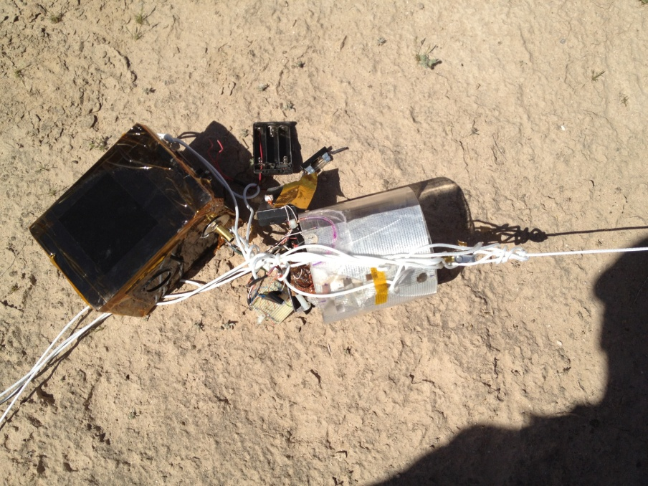
Recovery

Slide 9
Recovery
Of course we never recovered it, so we not only had no data, but also no pictures. At this point we called catastrophic failure of mission and chalked it up to a valuable learning experience.

Slide 10
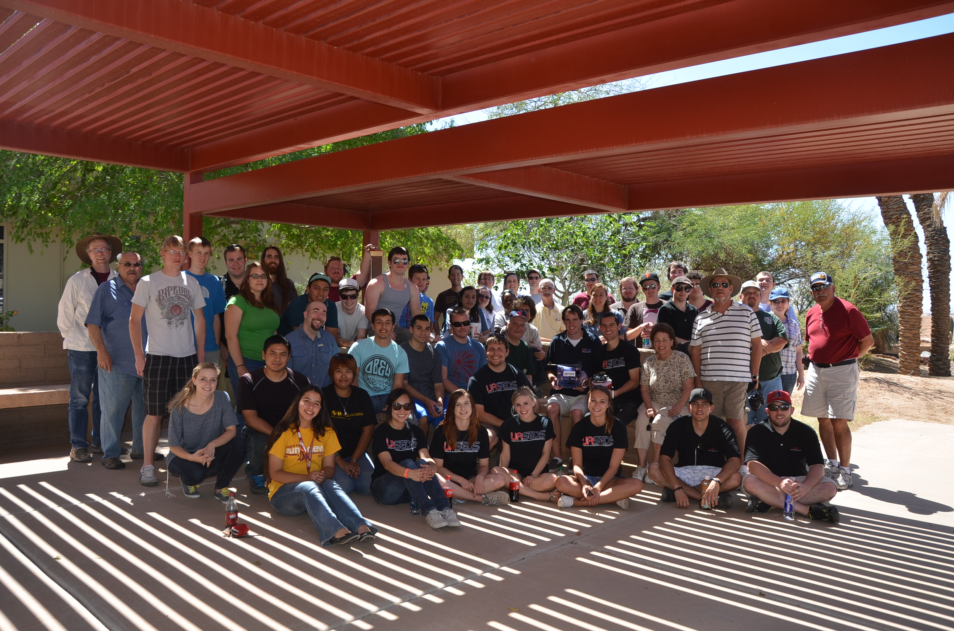
Recovery
We soon found that the one functioning part of the payload, the camera, had fallen out of the capsule when it busted open, most likely being destroyed after a 90,000-foot freefall.
Of course we never recovered it, so we not only had no data, but also no pictures. At this point we called catastrophic failure of mission and chalked it up to a valuable learning experience.

